Slide 1
Ramniranjan Jhunjhunwala College of Arts, Science And Commerce
(Autonomus)
Student Project Presentation
(28-01-2022)
Presented By:-
Om Maurya
Ladli Bhagat

Slide 2

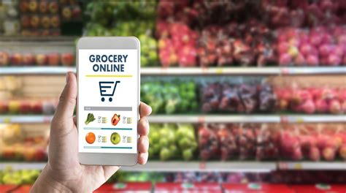
Market Basket Analysis

Slide 3
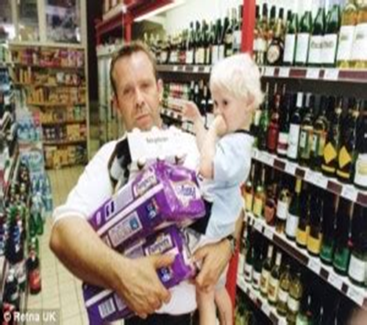
INTRODUCTION
​
Market Basket Analysis :- Buying a certain group of items likely to buy ​another group of items​.
To Analyze the customer behavior​.
Example - Diapers beer story.

Slide 4



METHODOLOGY
Secondary data
Excel
Python
Tableau

Slide 5
OBJECTIVE
To provide recommendations based on the users' preferences
To Increase the sales.

Slide 6
Project Analysis and Conclusions

Slide 7
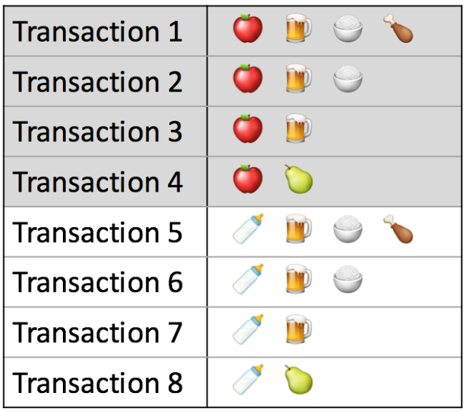

ANALYSIS
Association Rule
Support = $\frac{FREQUENCY}{TOTAL NO. OF OBSERVATION}$
Step 1: Support of all items :-
Items | Support
Apple | 4/8 = 50%
Beer | 6/8 = 75%
Milk | 4/8 = 50%
rice | 4/8 = 50%
guava | 2/8 = 25%
chicken | 2/5 = 50%
MIN SUPPORT:50%

Slide 8
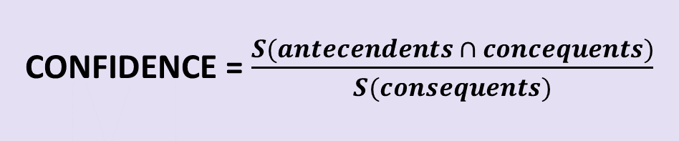
CONFIDENCE = $\frac{S(antecendents ∩ concequents)}{S(consequents)}$
Step2: will make rules
antecedents | consequents | support | confidence
Apple | beer | 3/8 | (3/8)/(6/8)=0.50
beer | apple | 3/8 | (3/8)/(4/8)=0.75
rice | milk | 2/8 | (2/8)/(4/8)=0.5
milk | rice | 2/8 | (2/8)/(4/8)=0.5
apple | Rice | 2/8 | (2/8)/(4/8)=0.5
rice | apple | 2/8 | (2/8)/(4/8)=0.5
milk | beer | 3/8 | (3/8)/(6/8)=0.5
beer | milk | 3/8 | (3/8)/(4/8)=0.75
rice | beer | 4/8 | (3/8)/(6/8)=0.5
beer | rice | 4/8 | (3/8)/(4/8)=0.75
Then we set min threshold = 0.75
antecedents | consequents | support | confidence
beer | apple | 3/8 | (3/8)/(4/8)=0.75
beer | milk | 3/8 | (3/8)/(4/8)=0.75
beer | rice | 4/8 | (3/8)/(4/8)=0.75

Slide 9

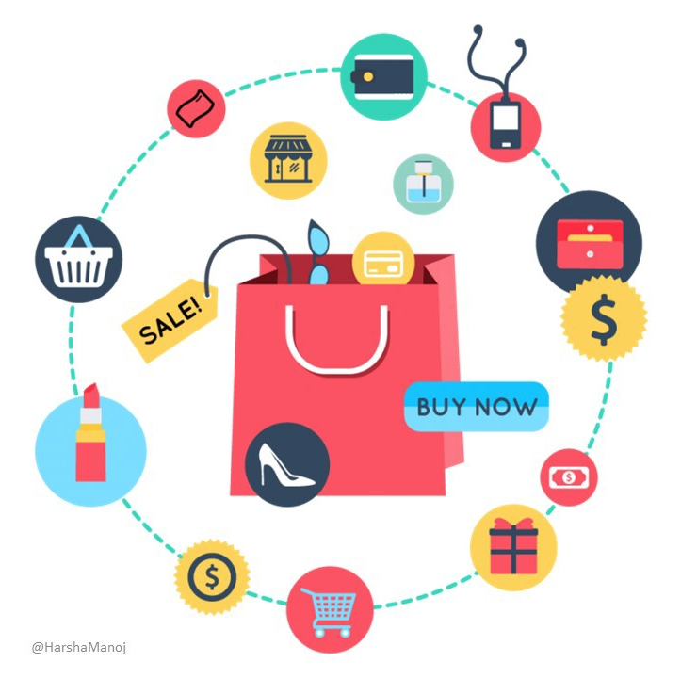
Apriori Algorithm
It is an algorithm for frequent item set mining and association rule.
Identifying the frequent individual items.

Slide 10
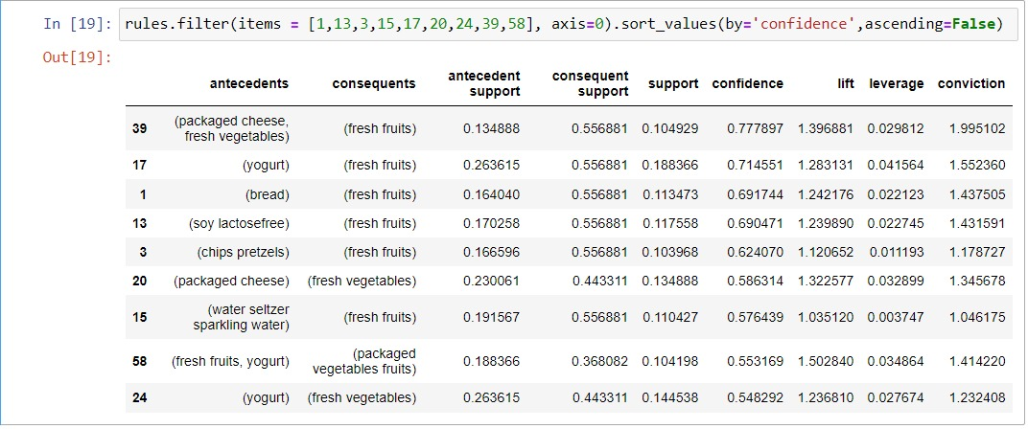
Minimum support is 0.1
Minimum Threshold =0.5 for confidence
Output :-

Slide 11
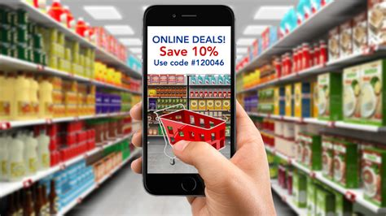
CONCLUSIONS
Recommendation on items.
According to final result we will target our new customers.
Increase in sale.

Slide 12

Thank you

